Slide 1
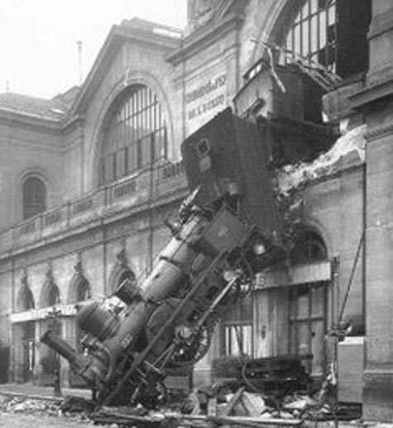
SAE ARP 4754A/4761 – Safety Assessments Part 2
http://tinyurl.com/3jvoqyh

Slide 2
Certification of Avionics Embedded Systems
In collaboration with Marinvent Corporation
Chapter 4.1
SAE ARP4754 and 4761 Safety Assessments Part 2
presented by:
John Maris
john@marinvent.com

Slide 3

Caution
    This module is designed to show the application of the certification principles contained in the others chapters. As such, it touches upon many aspects of the certification process, but the material is not complete, comprehensive, or necessarily current with the latest regulations and guidance materials. For these reasons, the analysis contained in the following slides should not be used as the basis of a certification program for the system under investigation.

Slide 4
Summary
    4.1 SAE ARP 4754 and 4761 Safety Assessments
      4.1.1 Why SAE ARP4754/4761?
      4.1.2 Failure Conditions Classification (SAE ARP4754)
      4.1.3 Safety Assessment Analysis Methods
      4.1.4 Fault Tree Construction
      4.1.5 Dependence Diagram (DD)
      4.1.6 Markov Analysis (MA)
      4.1.7 Markov Diagram
      4.1.8 Failure Mode and Effects Analysis (FMEA)
      4.1.9 FMEA Worksheet Example
      4.1.10 Failure Mode and Effects Summary (FMES)
      4.1.11 FMES Example
      4.1.12 Common Cause Analysis
      4.1.13 Zone Safety Analysis (ZSA)
      4.1.14 Particular Risk analysis (PRA)
      4.1.15 Common Mode Analysis (CMA)

Slide 5
Overview
  Why SAE ARP4754/4761?
  Safety Assessment Analysis Methods:
    Fault Tree Analysis (FTA)
    Dependence Diagram (DD)
    Markov Analysis (MA)
    Failure Modes and Effects Analysis (FMEA)
    Failure Modes and Effects Summary (FMES)
    Common Cause Analysis (CCA)
    Zonal Safety Analysis (ZSA)
    Particular Risk Analysis (PRA)
    Common Mode Analysis (CMA)

Slide 6
4.1.1 Why SAE ARP4754/4761?
SAE ARP documents are Aerospace Recommended Practices, not regulations or standards.
ARP documents are usually invoked by other guidance material, such as other SAE documents, Aeronautical Circulars (ACs), RTCA documents, or Technical Standard Orders (TSOs).
Alternative methods of compliance are acceptable, but the onus of proof is on the applicant
Continuing with the Integrated Modular Architecture (IMA) Avionics example from earlier classes, we note the following trail:

Slide 7
4.1.2 Failure Condition Classification (SAE ARP4754)
AC 20-170 (for IMAs) leads to TSO C-153, which states:
  The failure condition classification(s) will depend on the implemented functions and their intended use in a specific aircraft environment. This classification is beyond the scope of this TSO and must be determined by the safety assessment (SSA) conducted as part of the installation approval (i.e. SAE ARP4754/4761) (some paraphrasing and emphasis added)

Slide 8
4.1.3 Safety Assessment Analysis Methods
A brief overview follows for the following methods from SAE ARP4761:
  Fault Tree Analysis (FTA)
  Dependence Diagram (DD)
  Markov Analysis (MA)
  Failure Modes and Effects Analysis (FMEA)
  Failure Modes and Effects Summary (FMES)
  Common Cause Analysis (CCA)
  Zonal Safety Analysis (ZSA)
  Particular Risk Analysis (PRA)
  Common Mode Analysis (CMA)

Slide 9
4.1.3 Safety Assessment Analysis Methods (cont’d)
Fault Tree Analysis / Dependence Diagram / Markov Analysis (FTA/DD/MA):
  A top-down deductive (Boolean) qualitative analysis, conducted as part of the PSSA and SSA, that identifies failures and combinations that lead to identified undesired events.
  Uses the Failure Conditions identified in the FHA to determine which single and combination of low-level failures might cause each Failure Condition. I.e. if the failure conditions are the identified undesirable outcomes, what low-level failures can give rise to them.
  If used in conjunction with the FMEA/FMES, FMEA Significant Events are FTA Basic Events, with their failure rates deriving from the FMEA and/or FMES.
  Detailed instructions for performing FTA/DD/MA are in SAE ARP4761 Appendices D, E, F respectively.
  FTA Example: “Un-annunciated Loss of All Wheel Braking” from SAE ARP4761, Figure L3, p198.

Slide 10
4.1.4 Fault Tree Construction (ARP 4761 APPENDIX D)
State undesirable top-level event.
Develop upper and intermediate tiers of fault tree.
Develop each fault event until root cause is established.
Establish failure probability budgets and evaluate system’s ability to comply with safety objectives. Redesign if necessary (PSSA process).
FTA Example: “Un-annunciated Loss of All Wheel Braking” from SAE ARP4761, Figure L3, p198.

Slide 11
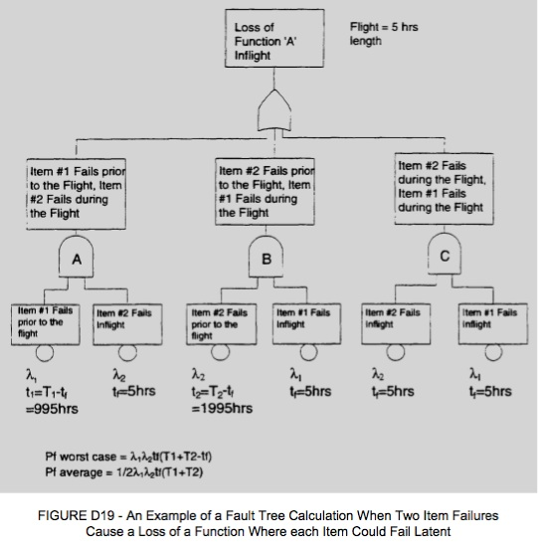
4.1.4 Fault Tree Construction (ARP 4761 APPENDIX D) (cont’d)
Question: why is the case with two latent (undetected) failures not considered?

Slide 12
4.1.5 Dependence Diagrams (DD) (SAE ARP4761 APPENDIX E)
Alternative pictorial depiction of Fault Tree Analysis.
The main difference is that FTAs use logic symbols and intermediate events, while DDs show logic by means of serial and parallel arrangement of events.
The logic and calculations of FTAs and DDs are the same.

Slide 13
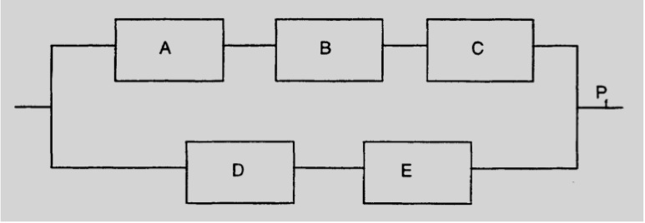
4.1.5 Dependence Diagram (DD)
(SAE ARP4761 Appendix E) (cont’d)
The probability of the overall Failure Condition Pf in the DD shown in Figure E1 is approximately given by:
Pf =(PfA+PfB+PfC)*(PfD+PfE) per flight

Slide 14
4.1.6 Markov Analysis (MA) (SAE ARP4761 APPENDIX E)
Markov Models use differential mathematics, Laplace Transforms, complex language, and probability chains to represent the system states and their interrelationships.
Tougher conceptually than FTAs and DDs, but more applicable to fault-tolerant systems.
MA is well suited to systems with potentially undetectable latent failures.
Markov models grow exponentially with the number of components.
For simplicity we try to use FTAs and DDs whenever possible, subject to 2 and 3 above.

Slide 15
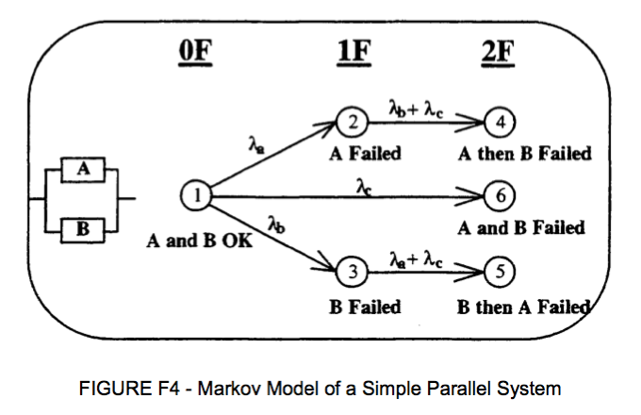
4.1.7 Markov Diagram (SAE ARP4761 Appendix F)
Figure 4.1.1 – Markov Model of a Simple Parallel System

Slide 16
4.1.8 Failure Modes and Effects Analysis (FMEA) (SAE ARP4761 Appendix G)
FMEAs use a systematic bottom-up method to identify the failure modes of a system, item, or function, and determine the failure effects on the next higher level.
Unlike the FTA, the FMEA starts with the failure of a single element, at a given system level, and examines its impact.
FMEAs may be Functional or Piece-Part. The latter are used when a refinement of the failure rate is required to meet the failure budget.
FMEAs may be quantitative or qualitative. The latter uses service history and industry source data as inputs (e.g. MIL-HDBK-217, MIL-HDBK-338, etc. See SAR ARP4761 G.3.2)
Quantitative FMEAs can provide inputs to probabilistic techniques such as FTAs.
FMEAs usually identify failures, and their detection.

Slide 17
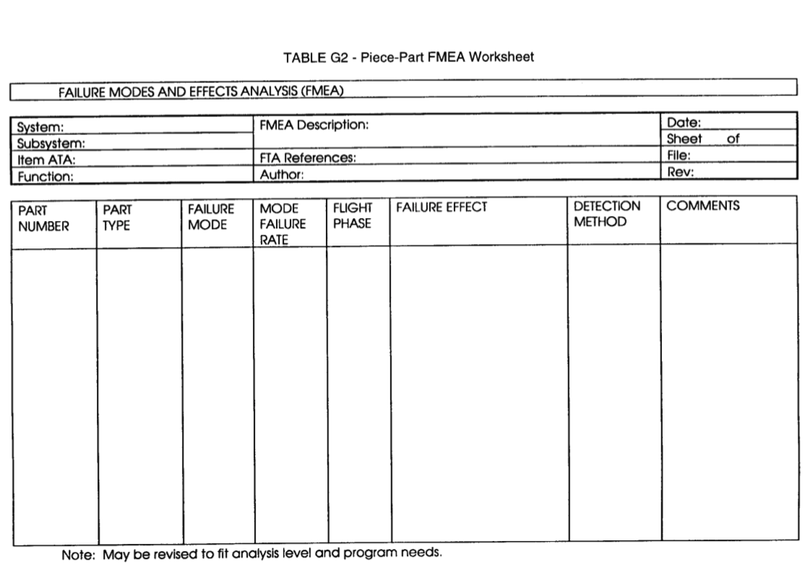
4.1.9 FMEA Worksheet Example

Slide 18
4.1.10 Failure Modes and Effects Summary (FMES) (SAE ARP4761 Appendix H)
An FMES is a grouping of single failure modes which produce the same failure effect (i.e., each unique failure effect has a separate grouping of single failure modes).
An FMES can be compiled from the aircraft manufacturer’s, system integrator’s or equipment supplier’s FMEAs.
An FMES should be coordinated with the user to adequately address the need for inputs to higher level FMEAs and/or System Safety Assessment FTAs.
The FMES is used as an input into an FTA or other analyses.

Slide 19
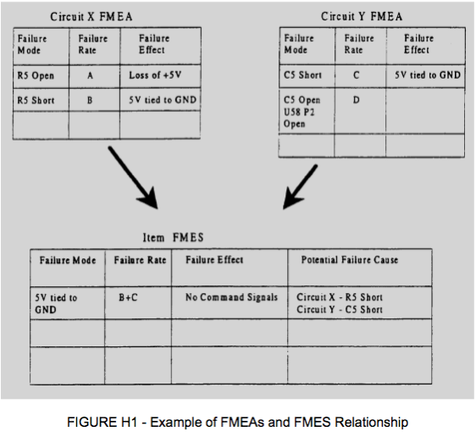
4.1.11 FMES Example (SAE ARP4761 Appendix H)
Figure 4.1.2 – Example of FMEAs and FMES Relationship

Slide 20
4.1.12 Common Cause Analysis (CCA)
CCA identifies individual failure modes or external events which can lead to a catastrophic or hazardous/severe-major failure condition (so-called “single-point failures”)
Such common cause events must be precluded for catastrophic failure conditions and must be within the assigned probability budget for hazardous/severe-major failure conditions.
CCA ensures risks associated with functional dependencies are acceptable.
Three types of CCA:
  Zonal Safety Analysis
  Particular Risks Analysis
  Common Mode Analysis

Slide 21
4.1.13 Zonal Safety Analysis (ZSA)
Performed on each zone of the aircraft to ensure safety requirements are met for:
  Basic Installation. (The installation should be checked against the appropriate design and installation requirements.)
  Interference Between Systems. (The effects of failures of equipment should be considered with respect to their impact on other systems and structure falling within their physical sphere of influence.)
  Maintenance Errors. (Installation maintenance errors and their effects on the system or aircraft should be considered.)

Slide 22
4.1.14 Particular Risk Analysis (PRA)
Defined as those events or influences which are outside the system(s) and item(s) concerned, but which may violate failure independence claims. Some of the example risks shown here require analysis because of airworthiness regulations, while others arise from known external threats to the aircraft or systems. Typical risks include, but are not limited to the following.
  Fire
  High Energy Devices
  Leaking Fluids
  Hail, Ice, Snow
  Bird Strike
  Tread Separation from Tire
  Wheel Rim Release
  Lightning
  High Intensity Radiated Fields
  Flailing Shafts

Slide 23
4.1.15 Common Mode Analysis (CMA)
CMA is performed to verify that ANDed events in the FTA/DD and MA are independent in the actual implementation.
The effects of design, manufacturing, maintenance errors and failures of system components which defeat their independence should be analyzed.
Considerations should be given to the independence of functions and their respective monitors. Item with identical hardware and/or software could be susceptible to generic faults which could cause malfunctions in multiple items.

Slide 24
4.1.15 Common Mode Analysis (CMA) (cont’d)
Common mode faults can fall into several categories which should be analyzed. The following are some examples of common mode faults:
  Hardware Error
  Software Error
  Hardware Failure
  Production/Repair Flaw
  Situation Related Stress (e.g., abnormal flight conditions or abnormal system configurations)
  Installation Error
  Requirements Error
  Environmental Factors (e.g., temperature, vibration, humidity, etc.)
  Cascading Faults
  Common External Source Faults

Slide 25
References
SAE Aerospace Recommended Practice ARP4754A Guidelines for Development of Civil Aircraft and Systems, Rev A, 2010/12
SAE Aerospace Recommended Practice ARP4761 Guidelines and Methods for Conducting the Safety Assessment Process on Civil Airborne Systems and Equipment, Rev A, 1996/12

Slide 26

Questions?

Slide 27
Image References
Figure 5.1.1: http://wwwapps.tc.gc.ca/saf-sec-sur/2/nico-celn/c_s.aspx?lang=eng
Figure 5.1.2: Courtesy of Marinvent Corporation

